Slide 1
OOAD
Class Diagram

Slide 2
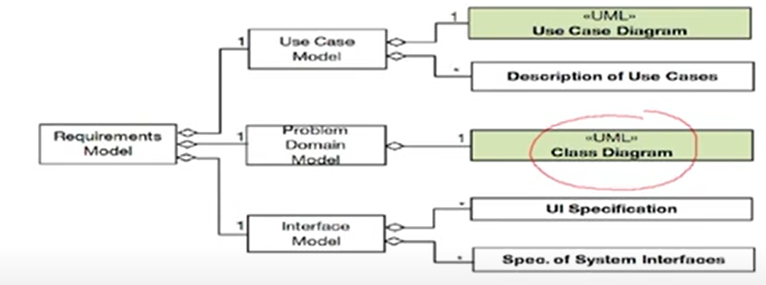
Class Diagram
At Requirement phase, the class diagram used to identify the major abstractions.
At this stage attributes and operations may not be known and classes may be identified as domain models.

Slide 3
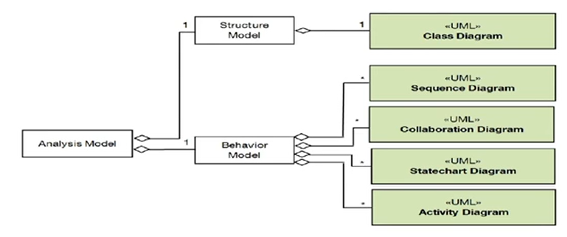
Cont..
Analysis phase of SDLC: Refine the identified domain models and analyse each abstraction attributes and operations.

Slide 4
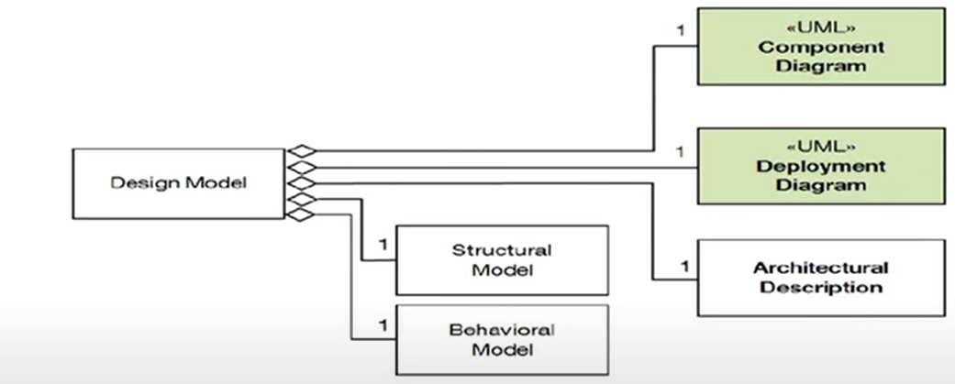
Cont...
Design phase: Class diagram include in the structural model
As we go from HLD→ LLD, implementation classes may be added

Slide 5
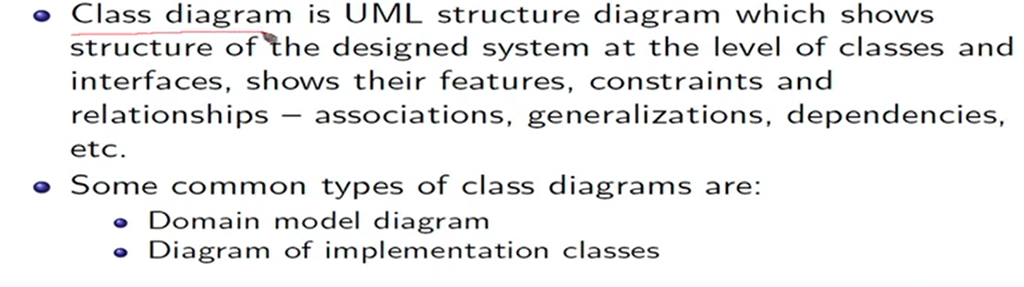
Class Diagram

Slide 6
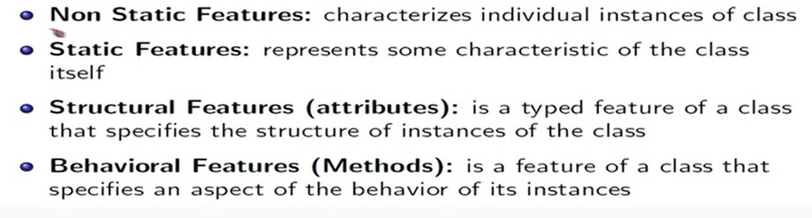
Features of a class

Slide 7
Class Diagrams
Class diagram is basically a graphical representation of the static view of the system and represents different aspects of the application. So a collection of class diagrams represent the whole system.
Each class is represented by a rectangle subdivided into three compartments
Name
Attributes
Operations
Modifiers are used to indicate visibility of attributes and operations.
‘+’ is used to denote Public visibility (everyone)
‘#’ is used to denote Protected visibility (friends and derived)
‘-’ is used to denote Private visibility (no one)
By default, attributes and operations are hidden.
The last two compartments may be omitted to simplify the class diagrams

Slide 8
Cont..
A class is a description of a set of objects that share the same attributes, operations, relationships, and semantics. Graphically, a class is rendered as a rectangle, usually including its name, attributes, and operations in separate, designated compartments.
Name
Account_Name
- Custom_Name
- Balance
Attributes
+AddFunds( )
+WithDraw( )
+Transfer( )
Operations

Slide 9
Class Names
The name should be a noun or noun phrase
The name should be singular and description of each object in the class
The name should be meaningful from a problem-domain perspective
“Student” is better than “Student Data” or “S-record” or any other implementation driven name

Slide 10
Attributes
Attributes represent characteristics or properties of classes
They are place holders or slots that hold values
The values they hold are other objects (or primitive types)
Syntax :
[visibility] name [multiplicity] [:type] [=initial-value]

Slide 11
Cont..
visibility: public “+”, protected “#”, or private “-”
name: capitalize first letter of each word that makes up the name, except for the first
multiplicity: number, range, or sequence of number or ranges.
type: built-in type or any user-defined class
initial-value: any constant and user-defined object
A derived attribute is one that can be computed from other attributes, but doesn’t actually exist. For example, a Person’s age can be computed from his birth date. A derived attribute is designated by a preceding ‘/’ as in:
/ age : Date
Student
Student
+name[1]: String
+password[1]:String
+gradeLevel[1]: Integer
+grades[0..*]:Integer
+name[1]: String
+password[1]:String
+gradeLevel[1]: Integer
+grades[0..*]:Integer
+/gpa[1]:Double=Null

Slide 12
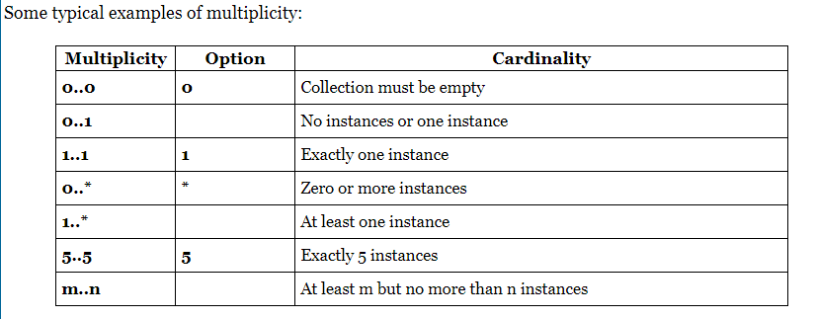
Multiplicity
Multiplicity is a definition of cardinality - i.e. number of elements
Some typical example of multiplicity

Slide 13
Operation Syntax
Operation is a behavioural features of class.
Operation is invoked on an instance of the classes for which the operation is a feature
[visibility] name [(parameter-list)] [:return-type]
visibility: “+”, “#”, “-” optional by default private
name: verb or verb phase, capitalize first letter of every word, except first
parameter-list: coma separated list of parameters
return-type: primitive type or user-defined type

Slide 14
Cont..
Direction of parameter is described as one of:
direction ::= 'in' | 'out' | 'inout' and defaults to 'in' if omitted.
in: passed by value
inout: passed by reference
out: value not passed into function rather the operation returns a value with in the parameter.
Student
+name[1]: String
+password[1]:String
+gradeLevel[1]: Integer
+grades[0..*]:Integer
+/gpa[1]:Double=Null
+addGrade(in grade:Integer=100)
+clearGrades()
+changePassword(in oldPassword:String, in newPassword:String):Boolean

Slide 15
Operations
Student
Class Section
major: String
GPA: Real
standing: String
name: String
capacity: Integer
takes>
add(Student)
drop(Student)
checkPrerequisites(Students)
add(Class Section)
drop(Class Section)
<has
Course
Prerequisite

Slide 16
Type of Relationships in Class Diagrams
1.Generalization
2.Association
3.Composition
4.Aggregation
5.Realisation
6.Dependency
Relation
Generalization
Association
Dependency
Binary Association
N-ary Association
Aggregation

Slide 17
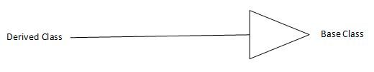
Generalization
When we create a base/super class from two or more similar type of objects by extracting their all common characteristics(attributes and behavior) and combine them, then this process is known as Generalization.
generalization: an inheritance relationship
inheritance between classes
interface implementation
Indicates that objects of the specialized class (subclass) are substitutable for objects of the generalized class (super-class).
“is –a-kind-of” relationship.

Slide 18
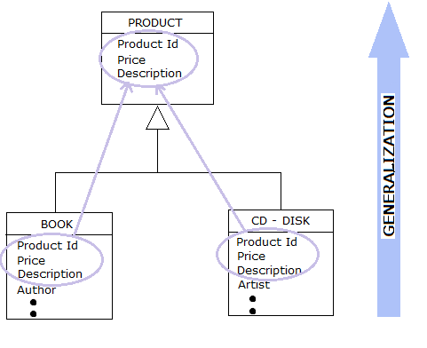
Cont..
Example : In the above figure the classes Book and Disk partially share the same attributes. During generalization, the shared characteristics such as Id, Price and description are combined and used to create a new super class Product. Book and Disk become sub classes of the class Product.

Slide 19
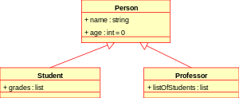
Cont..
Class diagram showing generalization between the super class Person and the two subclasses Student and Professor

Slide 20
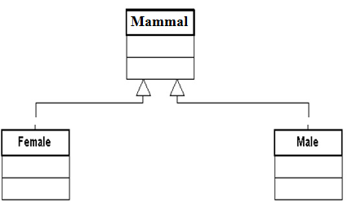
Generalization
A sub-class inherits from its super-class
Attributes
Operations
Relationships
A sub-class may
Add attributes and operations
Add relationships
Refine (override) inherited operation

Slide 21
C++ Example for Generalization
class 2DPoint { int x, y; }; class 3DPpoint : 2DPoint {
int z; };

Slide 22
Associations
Association is a relationship between classes which is used to show that instances of classes could be either linked to each other
A semantic relationship between two or more classes that specifies connections among their instances.
A structural relationship, specifying that objects of one class are connected to objects of a second (possibly the same) class.
Example: “An Employee works for a Company”
association: a usage relationship
dependency
aggregation
composition

Slide 23
Association Relationships
If two classes in a model need to communicate with each other, there must be link between them.
An association denotes that link.
Student
Instructor

Slide 24
Association Relationships (Cont’d)
Multiplicity
The number of instances of the class, next to which the multiplicity expression appears, that are referenced by a single instance of the class that is at the other end of the association path.
Provides a lower and upper bound on the number of instances
The example indicates that a Student has one or more Instructors:
Student
Instructor
1..*

Slide 25
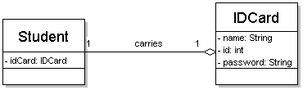
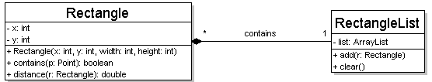
Multiplicity of associations
one-to-one
each student must carry exactly one ID card
one-to-many
one rectangle list can contain many rectangles
25

Slide 26
Association Relationships (Cont’d)
The example indicates that every Instructor has one or more Students:
Student
Instructor
1..*

Slide 27
Association Relationships (Cont’d)
Association Role
We can also indicate the behavior of an object in an association (i.e., the role of an object) using rolenames called association role
A role is an end of an association where it connects to a class.
May be named to indicate the role played by the class attached to the end of the association path.
Usually a noun or noun phrase
Multiplicity can also be added to the association role to indicate how many objects of one class relate to one object of another class.
learns from
teaches
Student
Instructor
1..*
1..*

Slide 28
Association Relationships (Cont’d)
We can also name (label) the association.
membership
Student
Team
1..*
1..*

Slide 29
Associations
Navigation
The navigation of associations can be
uni-directional
bi-directional
unspecified
Navigation is specified by the arrow, not the label
teaches>
Class Section
Instructor
<works for
is instance of>
sponsors>
Department
Course

Slide 30

In short Associations:
Connect two classes
Have an optional label
Have multiplicities
Are directional
Have optional roles

Slide 31
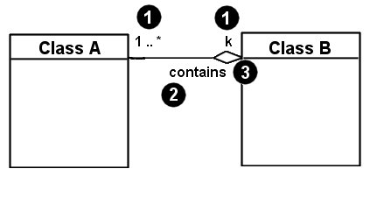
Associational relationships
associational (usage) relationships
1. multiplicity (how many are used)
* ⇒ 0, 1, or more
1 ⇒ 1 exactly
2..4 ⇒ between 2 and 4, inclusive
3..* ⇒ 3 or more
2. name (what relationship the objects have)
3. navigability (direction)
31

Slide 32
Associations
student
1
*
University
Person
0..1
*
employer
teacher
Multiplicity
Symbol Meaning
1 One and only one
0..1 Zero or one
M..N From M to N (natural language)
* From zero to any positive integer
0..* From zero to any positive integer
1..* From one to any positive integer
Role
“A given university groups many people; some act as students, others as teachers. A given student belongs to a single university; a given teacher may or may not be working for the university at a particular time.”

Slide 33
C++ Example
Association is typically implemented with a pointer or reference instance variable.
class A
{
private:
B* b;
};
A
B

Slide 34
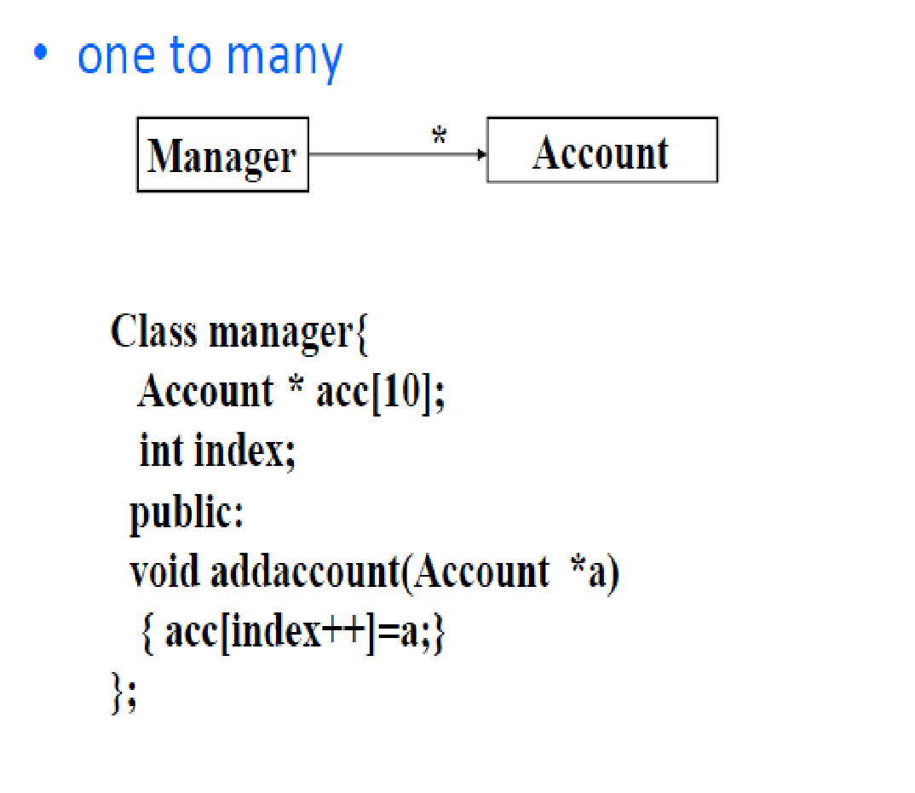
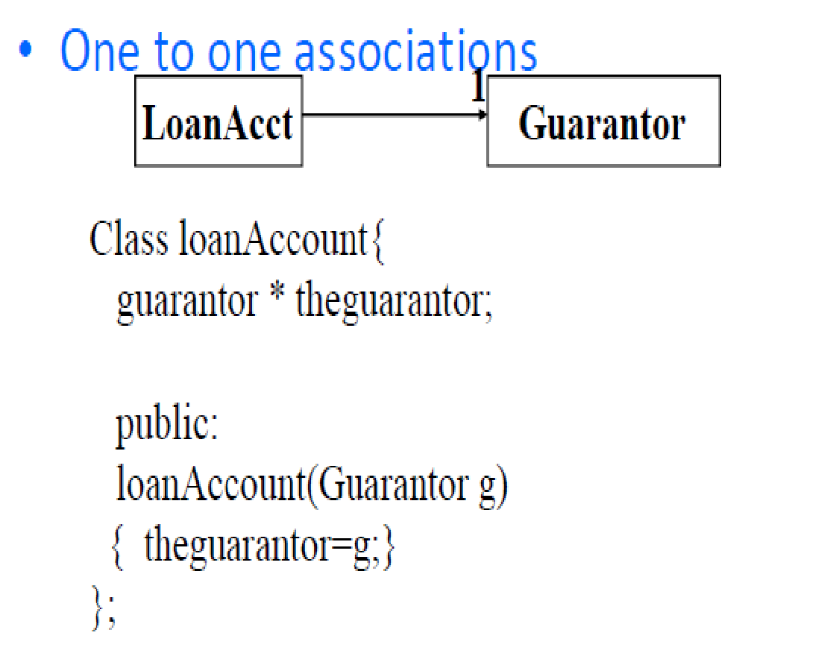
Cont..

Slide 35
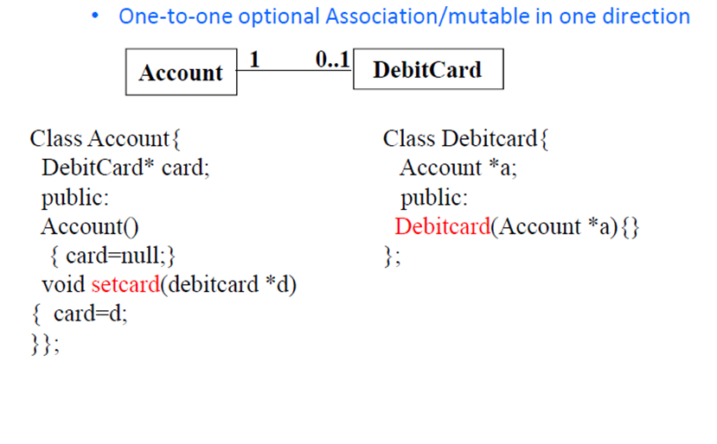
Cont..

Slide 36
Cont..
is registered for>
Student
Semester
1..*
0..*
1
takes>
is held during>
0..8
1..*
teaches>
Class Section
Instructor
1..3
0..6
1..*
<works for
is instance of>
1
sponsors>
1
1..*
Department
Course

Slide 37
Association types
aggregation: "is part of"
symbolized by a clear white diamond
composition: "is entirely made of"
stronger version of aggregation
the parts live and die with the whole
symbolized by a black diamond
dependency: "uses temporarily"
symbolized by dotted line
often is an implementation detail, not an intrinsic part of that object's state
Car
1
1
aggregation
Engine
Book
composition
1
*
Page
dependency
Lottery Ticket
Random
37

Slide 38
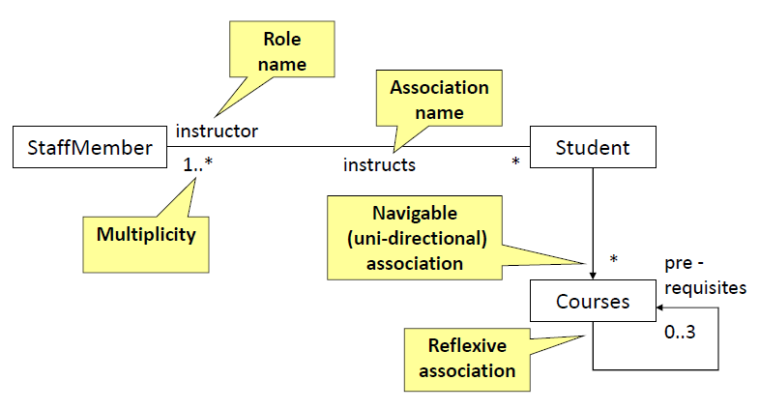
Association

Slide 39
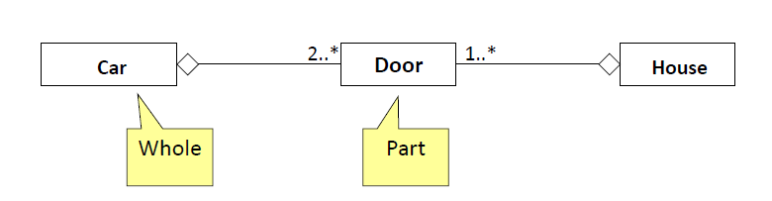
Aggregation
Aggregation is a special type of association used to model a "whole- parts" relationship. Where one class is considered as whole, made up of one or more classes comprising its parts.
To represent an aggregation relationship, you draw a solid line from the parent class to the part class, and draw an unfilled diamond shape on the parent class's association end.
A parts class can exist without a whole, but when they are aggregated to a whole, they are used to comprise that class.

Slide 40
Composition
A strong form of aggregation:
The whole is the sole owner of its parts. The part object may belong to only one whole.
The life time of the part class depend upon the whole class.
Destruction of the whole class means the destruction of the part classes.
Part classes are mandatory, multiplicity of at least one is always implied for the whole class.

Slide 41
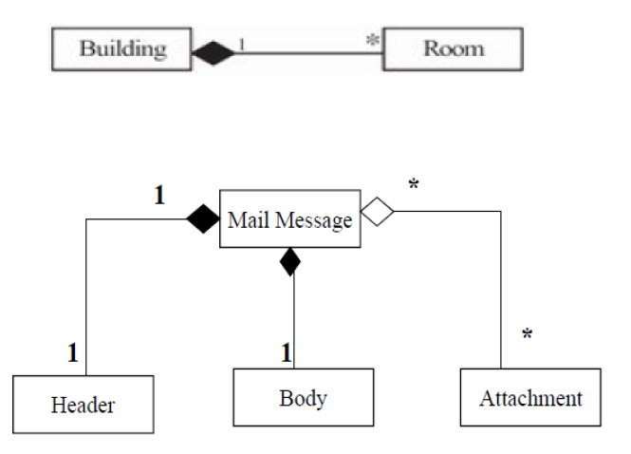
Composition
Composition relationship is drawn like the aggregation relationship, but this time the diamond shape is filled.

Slide 42
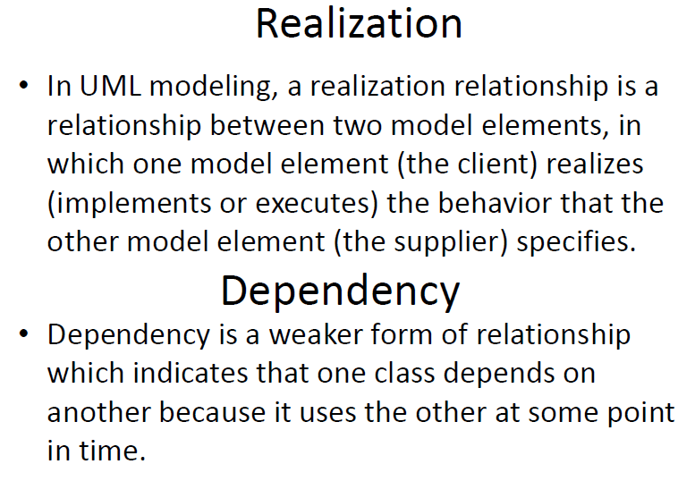
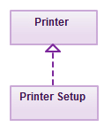
Realization
Realizations can only be shown on class or component diagrams. A realization is a relationship between classes, interfaces, components and packages that connects a client element with a supplier element.
symbolic of realization --------▻
In the example, the printing preferences that are set using the printer setup interface are being implemented by the printer.

Slide 43
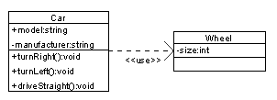
Dependencies
A dependency is a semantic connection between dependent and independent model elements. It exists between two elements if changes to the definition of one element (the server or target) may cause changes to the other (the client or source). This association is uni-directional.

Slide 44
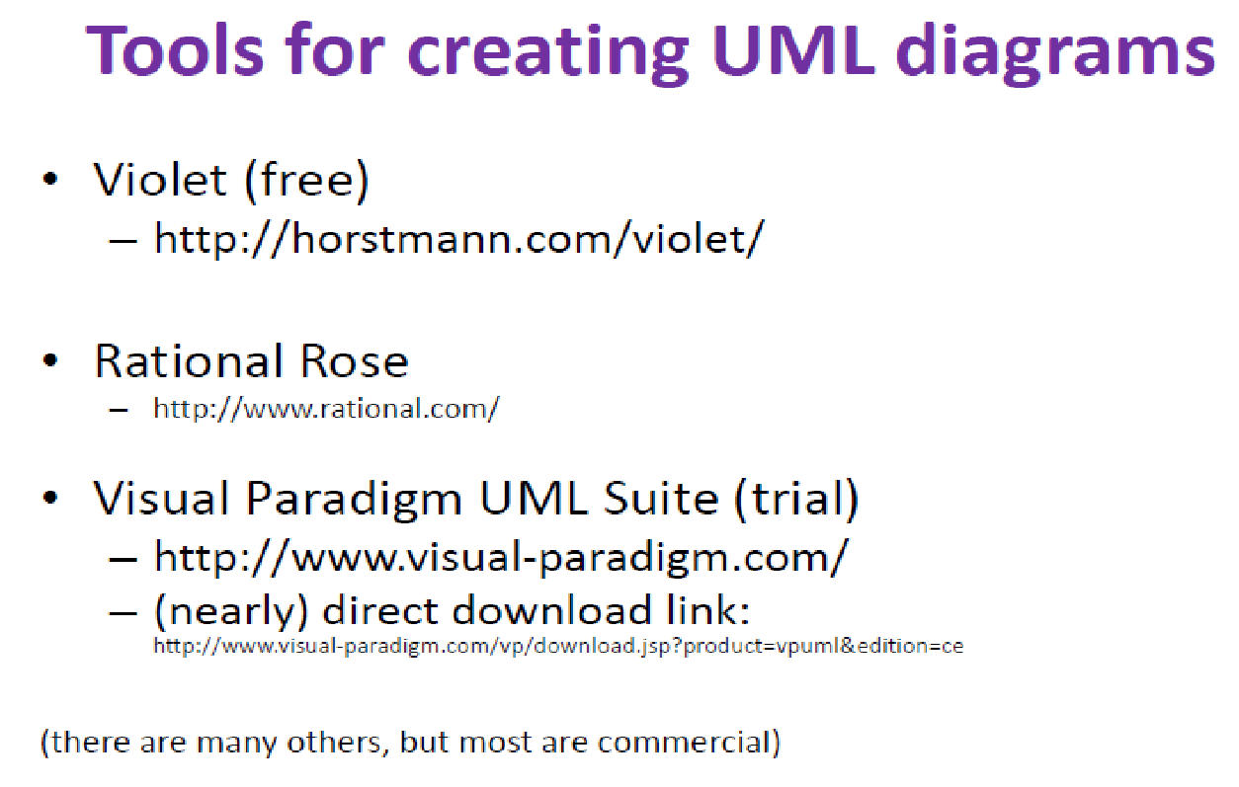
Tools for creating UML diagrams

Slide 45
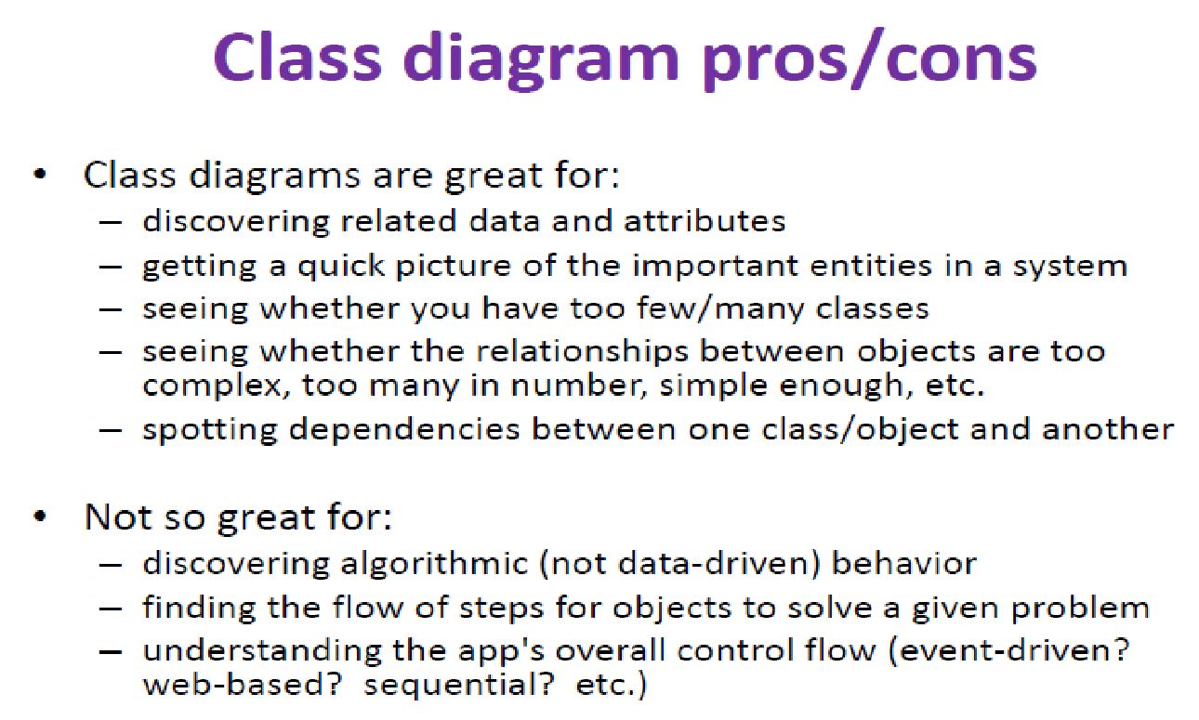
Class diagram pros/cons

Slide 46
Online shopping domain model
Purpose: Show some domain model for online shopping - Customer, Account, Shopping Cart, Product, Order, Payment.
Summary: Each customer has unique id and is linked to exactly one account. Account owns shopping cart and orders. Customer could register as a web user to be able to buy items online. Customer is not required to be a web user because purchases could also be made by phone or by ordering from catalogues. Web user has login name which also serves as unique id. Web user could be in several states - new, active, temporary blocked, or banned, and be linked to a shopping cart. Shopping cart belongs to account.
Account owns customer orders. Customer may have no orders. Customer orders are sorted and unique. Each order could refer to several payments, possibly none. Every payment has unique id and is related to exactly one account.
Each order has current order status. Both order and shopping cart have line items linked to a specific product. Each line item is related to exactly one product. A product could be associated to many line items or no item at all.

Slide 47
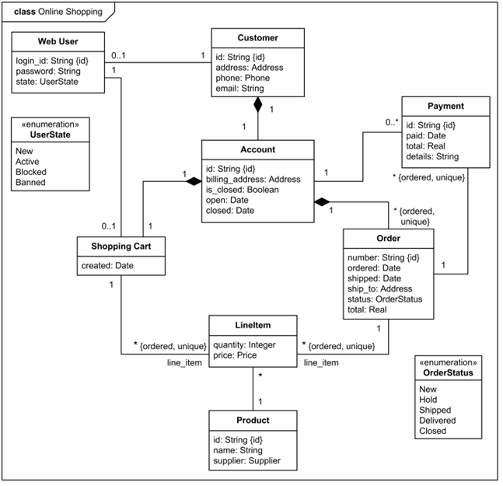
Example

